Slide 1
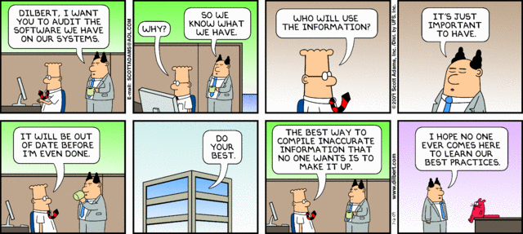

Slide 2
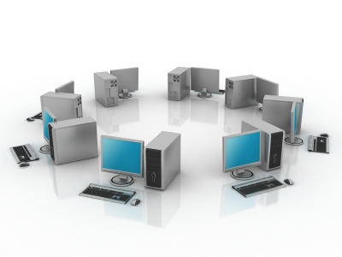
Organizations, Management, and the Networked Enterprise
Chapter 2
Global e-Business: How Businesses Use Information Systems
MFIS
Lisa Murphy
Notes:
2

Slide 3

Learning Objectives
To gain an understanding of the following:
Define and describe business processes and their relationship to information systems
Evaluate the role played by systems serving the various levels of management in a business and their relationship to each other
Explain how enterprise applications, collaboration and communication systems, and intranets improve organizational performance
Explain the difference between e-business, e-commerce, and e-government
Assess the role of the information systems function in a business

Slide 4
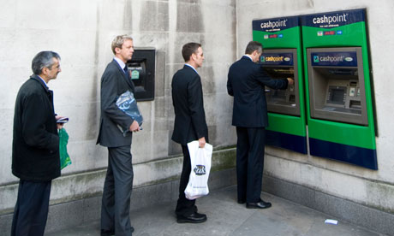
Queue in a Bank
Is there anything wrong here?

Slide 5
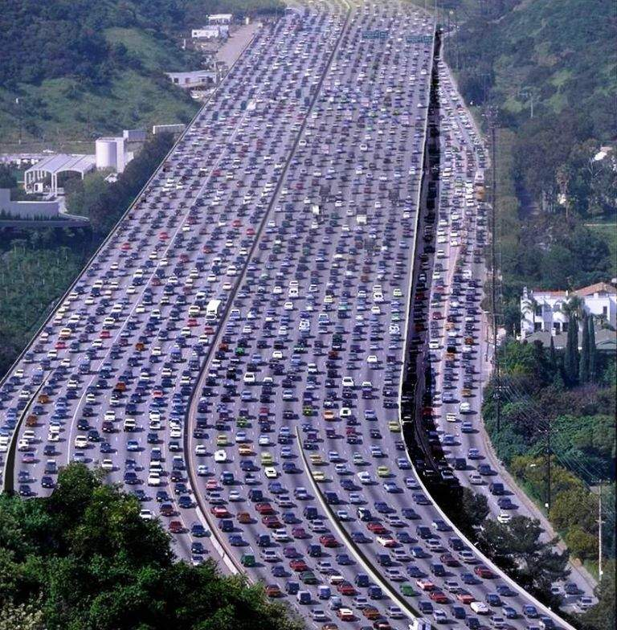
Traffic jam
Does this look OK to you?
What would you do to improve this situation?

Slide 6
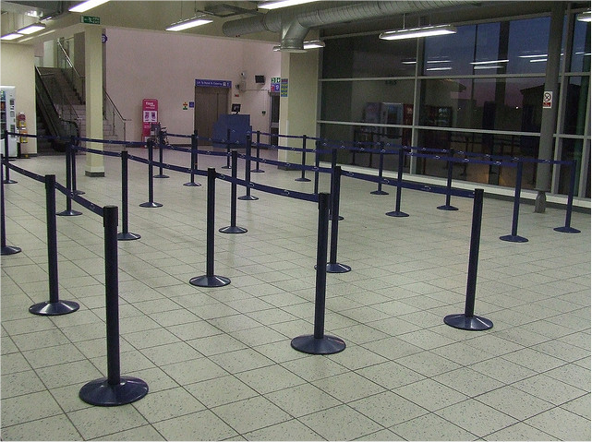
Empty Queue
What’s wrong here?

Slide 7

Airplanes in queue at JFK
How can this happen?

Slide 8
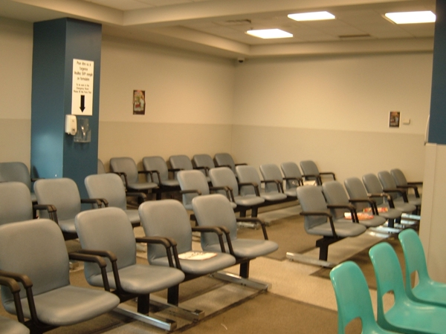

Hospital Waiting Rooms
Could you do better?

Slide 9
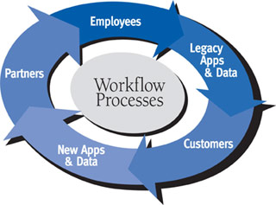
Business Processes
Business processes:
Workflows of material, information, knowledge
Sets of activities, steps
May be tied to functional area or be cross-functional
Businesses: Can be seen as collection of business processes
Business processes may be assets or liabilities

Slide 10


What are the process steps for ordering a hamburger?

Slide 11
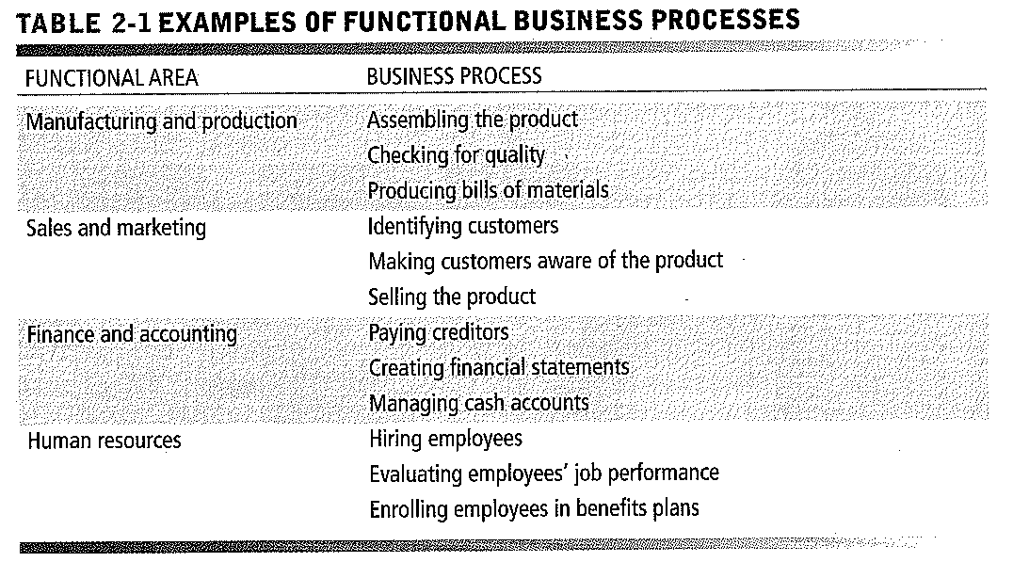
Business Processes and Information Systems

Slide 12
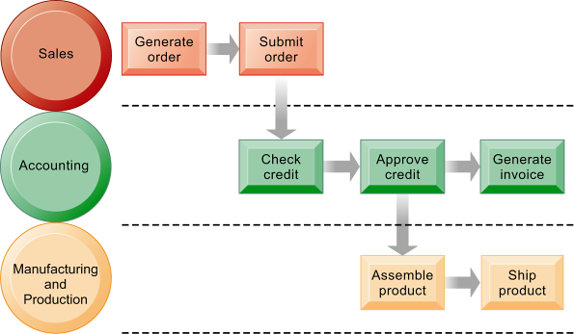
The Order Fulfillment Process
Fulfilling a customer order involves a complex set of steps that requires the close coordination of the sales, accounting, and manufacturing functions.

Slide 13
IT Enhancement
Information technology enhances business processes in two main ways:
Increasing efficiency of existing processes
Automating steps that were manual
Enabling entirely new processes that are capable of transforming the businesses
Change flow of information
Replace sequential steps with parallel steps
Eliminate delays in decision making
1.
2.

Slide 14
Types of Business Information Systems TPS
Transaction processing systems
Perform and record daily routine transactions necessary to conduct business
Examples: Sales order entry, payroll, shipping
Allow managers to monitor status of operations and relations with external environment
Serve operational levels
Serve predefined, structured goals and decision making

Slide 15
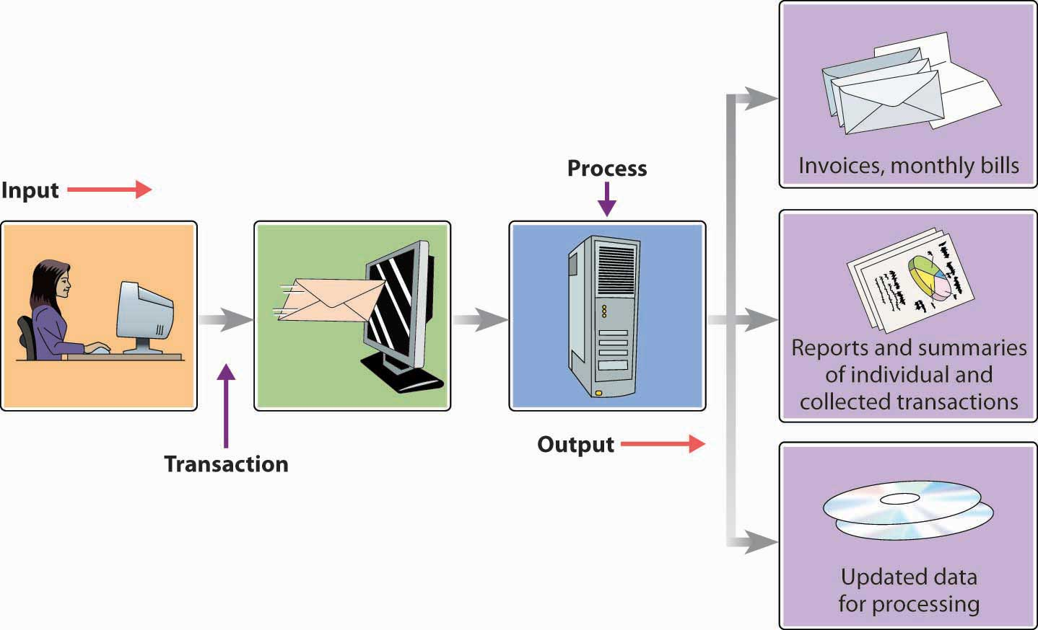
TPS

Slide 16
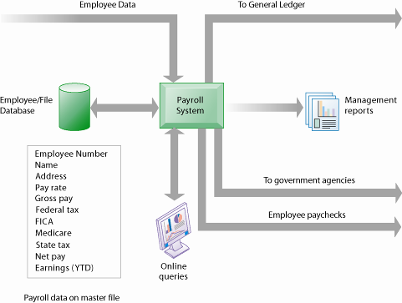
A Payroll TPS
A TPS for payroll processing captures employee payment transaction data (such as a time card). System outputs include online and hard-copy reports for management and employee paychecks.

Slide 17

E xercise 1 – Question Time
Identify a typical activity that would be recorded using the TPS?
How often would such an activity occur, and what member of staff would be
responsible for recording it ?
Individual work

Slide 18
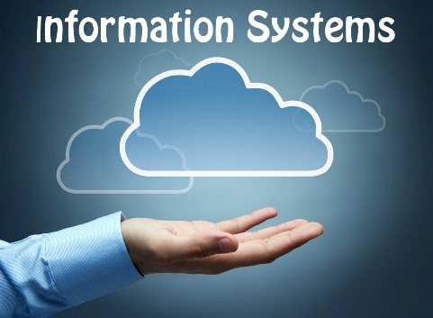
Types of Business Information Systems MIS
Management information systems
Serve middle management
Provide reports on firm’s current performance, based on data from TPS
Provide answers to routine questions with predefined procedure for answering them
Typically have little analytic capability

Slide 19
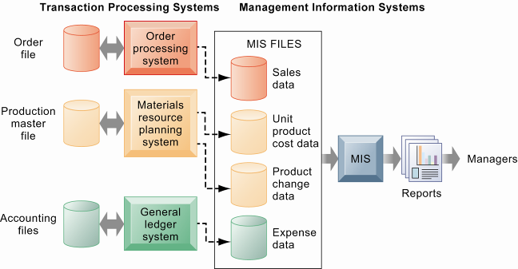
How Management Information Systems Obtain their Data from the Organization’s TPS
In the system illustrated by this diagram, three TPS supply summarized transaction data to the MIS reporting system at the end of the time period. Managers gain access to the organizational data through the MIS, which provides them with the appropriate reports.

Slide 20
E xercise 2 – Question Time
Make a list of all the different organisations that are likely to have recorded your personal details (UCT, sports club, cellphone company, hospital, school, church etc).
In what ways could this information have been useful in monitoring the (past) activities of the organisation?
In what ways could this information be used for future planning?
Individual work

Slide 21
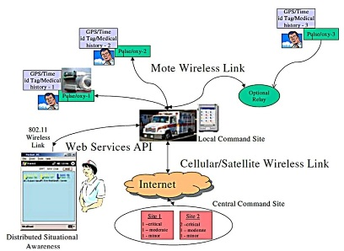
Types of Business Information Systems DSS
Decision support systems
Serve middle management
Support non routine decision making
Example: What is impact on production schedule if December sales doubled?
Often use external information as well from TPS and MIS
Model driven DSS
Voyage-estimating systems
Data driven DSS
Intrawest’s marketing analysis systems

Slide 22
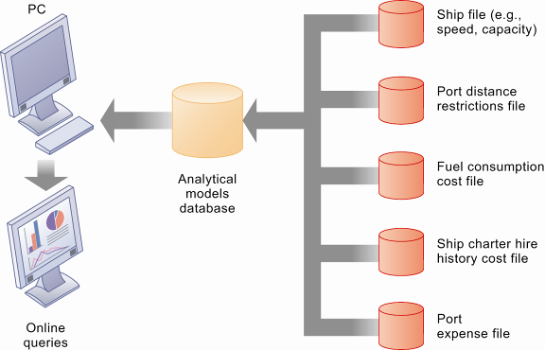
Voyage-Estimating Decision Support System
This DSS operates on a powerful PC. It is used daily by managers who must develop bids on shipping contracts.

Slide 23
Types of Business Information Systems ESS
Executive support systems
Support senior management
Address nonroutine decisions requiring judgment, evaluation, and insight
Incorporate data about external events (e.g. new tax laws or competitors) as well as summarized information from internal MIS and DSS
Example: ESS that provides minute-to-minute view of firm’s financial performance as measured by working capital, accounts receivable, accounts payable, cash flow, and inventory

Slide 24
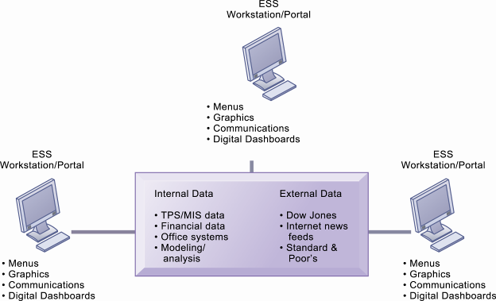
Model of an Executive Support System
This system pools data from diverse internal and external sources and makes them available to executives in easy-to-use form.

Slide 25

Break Time
10 Minutes break!!

Slide 26
Constituency – Who supports who?
Systems from a constituency perspective
Transaction processing systems: supporting operational level employees
Management information systems and decision-support systems: supporting managers
Executive support systems: supporting executives

Slide 27
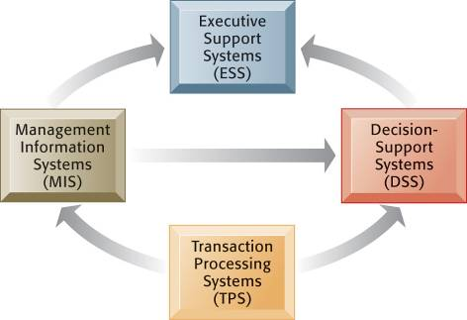
Interrelationships Among Systems
Relationship of systems to one another
TPS:
Major source of data for other systems
ESS:
Recipient of data from lower-level systems
Data may be exchanged between systems
In reality, most businesses’ systems only loosely integrated

Slide 28
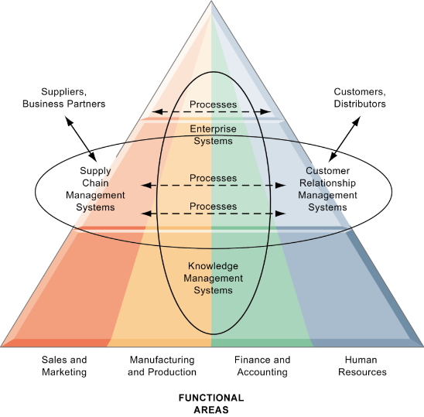
Systems that Span the Enterprise
Enterprise applications
Span functional areas
Execute business processes across firm
Include all levels of management
Four major applications:
Enterprise systems
Supply chain management systems
Customer relationship management systems
Knowledge management systems

Slide 29

1. What does an Enterprise System do?
Enterprise systems
Collects data from different firm functions and stores data in single central data repository
Resolves problem of fragmented, redundant data sets and systems
Enables:
Coordination of daily activities
Efficient response to customer orders (production, inventory)
Provide valuable information for improving management decision making

Slide 30
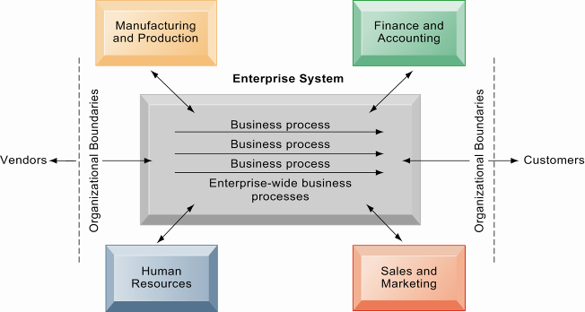
Enterprise Systems
Enterprise systems integrate the key business processes of an entire firm into a single software system that enables information to flow seamlessly throughout the organization. These systems focus primarily on internal processes but may include transactions with customers and vendors.

Slide 31
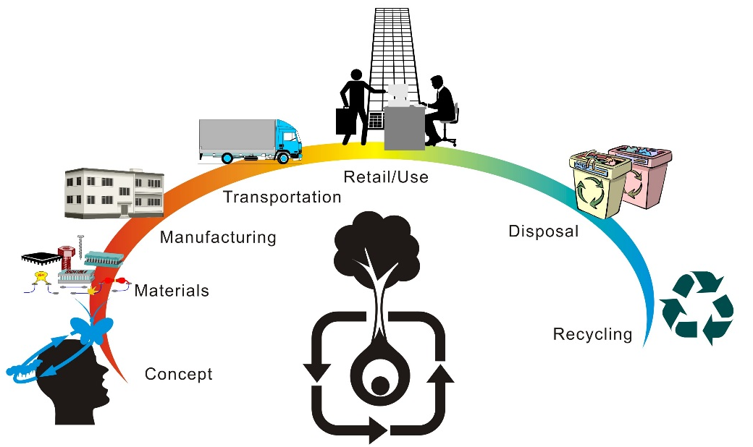
2. Supply Chain Management
Supply chain management systems
Manage firm’s relationships with suppliers
Share information about
Orders, production
Inventory levels
Delivery of products
Services
Goal: Right amount of products to destination with least amount of time and lowest cost

Slide 32
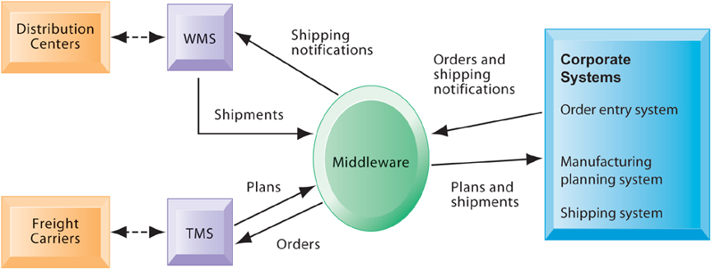
Example of a Supply Chain Management
Customer orders, shipping notifications, optimized shipping plans, and other supply chain information flow among Haworth’s Warehouse Management System (WMS), Transportation Management System (TMS), and its back-end corporate systems.

Slide 33
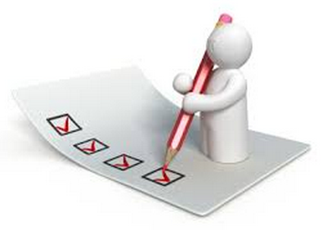
3. Customer relationship management systems
Customer relationship management systems
Provide information to coordinate all of the business processes that deal with customers in sales, marketing, and service to optimize revenue, customer satisfaction, and customer retention
Integrate firm’s customer-related processes and consolidate customer information from multiple communication channels

Slide 34
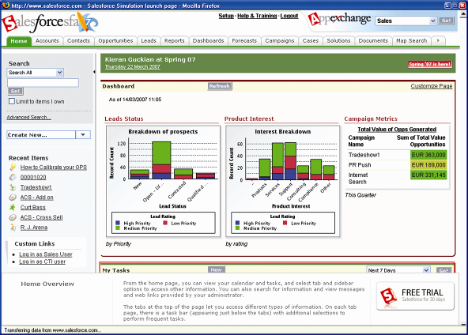
Salesforce.com Executive Team Dashboard
Illustrated here are some of the capabilities of Salesforce.com, a market-leading provider of on-demand customer relationship management (CRM) software. CRM systems integrate information from sales, marketing, and customer service.

Slide 35
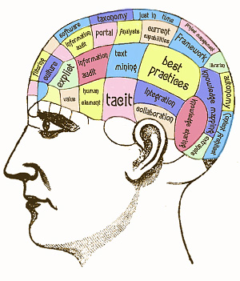
4. Knowledge management systems
Support processes for…
Acquiring
Creating
Storing
Distributing
Applying
Integrating
…knowledge

Slide 36

Knowledge management systems
Collect internal knowledge and link to external knowledge
Include enterprise-wide systems for managing:
Documents
Graphics
other digital knowledge objects
Directories of employees with expertise

Slide 37
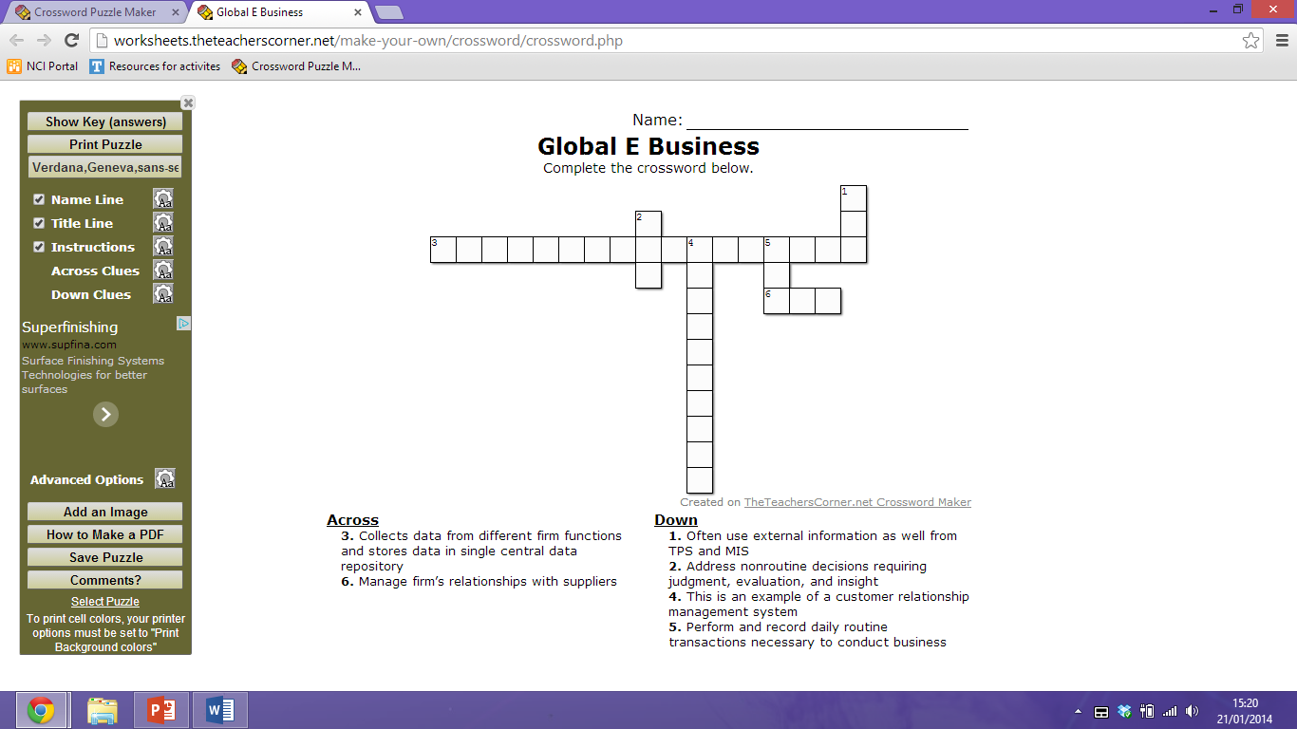
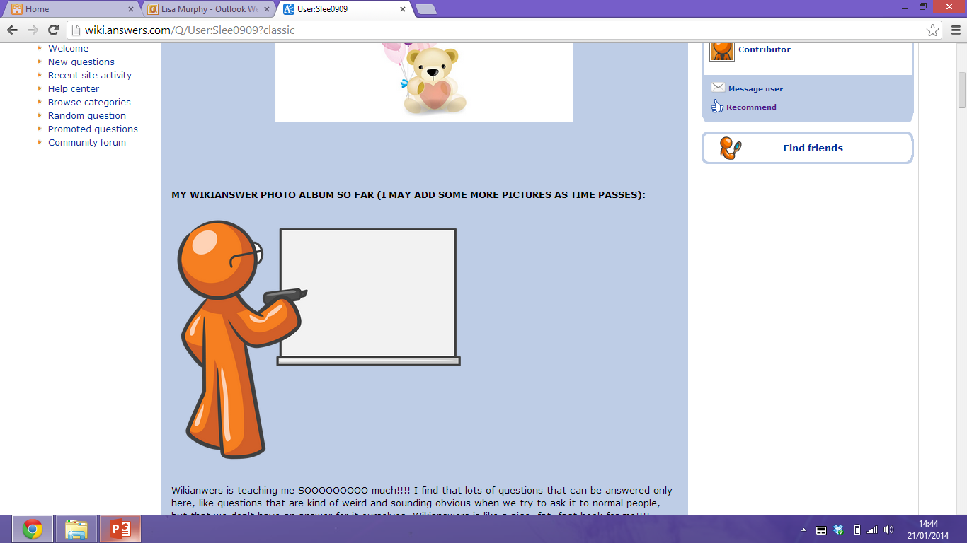
E xercise 3 – Crossword
Groups of 2

Slide 38
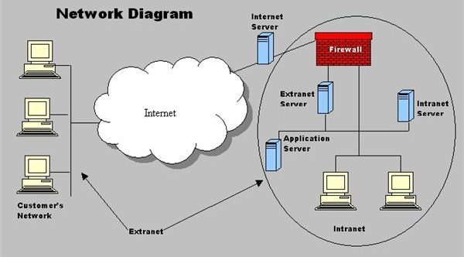
Intranets and Extranets
What is the difference??

Slide 39
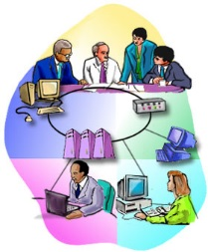
Intranets and Extranets
Intranets:
Internal networks built with same tools and standards as Internet
Used for internal distribution of information to employees
Typically utilize private portal providing single point of access to several systems
May connect to company’s transaction systems
Extranets:
Intranets extended to authorized users outside the company
Expedite flow of information between firm and its suppliers and customers
Can be used to allow different firms to collaborate on product design, marketing, and production

Slide 40

Three “e”s
e-Business:
Use of digital technology and Internet to execute major business processes in the enterprise
Includes e-Commerce:
Buying and selling of goods over Internet
e-Government:
The application of Internet and networking technologies to digitally enable government and public sector agencies’ relationships with citizens, businesses, and other arms of government

Slide 41

IT Department
Information systems department:
Formal organizational unit responsible for information technology services
Includes programmers, systems analysts, project leaders, information systems managers
Often headed by chief information officer (CIO), also includes chief security officer (CSO) and chief knowledge officer (CKO)
End-users:
Representatives of other departments, for whom applications are developed

Slide 42

IT Department
Small firm may not have formal information systems group
Larger companies typically have separate department which may be organized along one of several different lines:
Decentralized (within each functional area)
Separate department under central control
Each division has separate group but all under central control

Slide 43
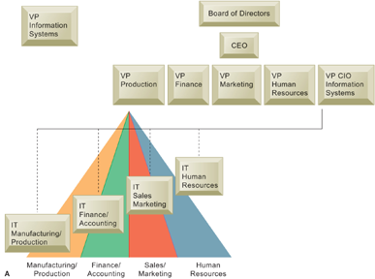
Organization of the IS Function
There are alternative ways of organizing the information systems function within the business:
Within each functional area
As a separate department under central control
Or represented in each division of a large multidivisional company but under centralized control

Slide 44
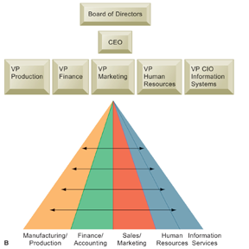
Organization of the IS Function
There are alternative ways of organizing the information systems function within the business:
Within each functional area
As a separate department under central control
Or represented in each division of a large multidivisional company but under centralized control

Slide 45
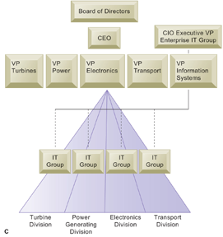
Organization of the IS Function
There are alternative ways of organizing the information systems function within the business:
Within each functional area
As a separate department under central control
Or represented in each division of a large multidivisional company but under centralized control

Slide 46

RECAP
To gain an understanding of the following:
Define and describe business processes and their relationship to information systems
Evaluate the role played by systems serving the various levels of management in a business and their relationship to each other
Explain how enterprise applications, collaboration and communication systems, and intranets improve organizational performance
Explain the difference between e-business, e-commerce, and e-government
Assess the role of the information systems function in a business

Slide 47

E xercise 1 – Minute paper
1. What are the two [three, four, five] most significant [central, useful, meaningful, surprising, disturbing] things you have learned during this session?
_______________________________________________________________
2. What question(s) remain uppermost in your mind?
_______________________________________________________________
3. Is there anything you did not understand?
_______________________________________________________________

